Slide 1
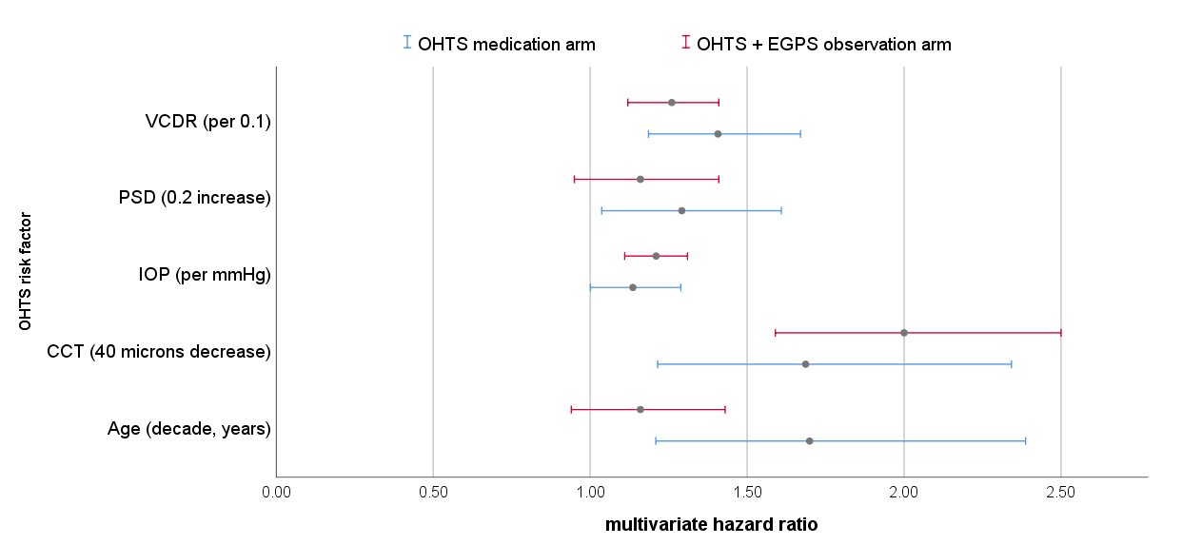
The OHTS 5-Year Risk Calculator is Applicable to Treated Patients
Ari Leshno, MD,^{1,2} Carlos Gustavo De Moraes, MD, MPH, PhD,¹ George A. Cioffi, MD,¹ Michael Kass, MD,³ Mae Gordon, PhD,³ Jeffrey M. Liebmann, MD¹
¹ Edward S. Harkness Eye Institute, Columbia University Irving Medical Center, New York, NY, USA; ² Sackler Faculty of Medicine, Tel Aviv University, Tel Aviv, Israel;
³ Department of Ophthalmology and Visual Sciences, Washington University School of Medicine, St. Louis, MO, USA.
BACKGROUND
Fig. 1 Comparison of HR for risk factors in the OHTS treatment arm compared to those used in OHTS-calculator¹
Results
The Ocular Hypertension Treatment Study 5-year risk calculator (OHTS calculator) is a valuable tool to estimate the risk of progression of untreated OHTN patients to primary open-angle glaucoma (POAG)
We evaluated the use of the OHTS calculator in treated OHTN patients
We also tested whether pretreated baseline IOP or treated IOP (mean measurements from the first 24 months) is more appropriate in that setting
The OHTS medication group HR were similar to those used in the OHTS Calculator for untreated OHTN (Fig. 1, P>0.1)
Using treated IOP provided good predictive accuracy (calibration chi-square = 10.4, Fig. 2a)
The OHTS Calculator risk score had poor predictive accuracy when baseline IOP was used for the OHTS medication group (calibration chi-square = 29, Fig. 2b)
Using treated IOP resulted in significant concordance between observed and predicted development (c-statistics 0.77, 95% CI 0.70-0.84, P<0.001)
The results with treated IOP are comparable to those reported previously using the OHTS calculator with baseline IOP on individuals in the observation arm of the combined OHTS and EGPS cohort¹
OHTS medication arm
OHTS+EGPS observation arm
*
Methods
* Treated IOP was used for the OHTS medication arm
Fig. 2 Goodness of fit for treated IOP (a) and baseline IOP (b) to estimate 5-year risk of POAG
Post hoc secondary analysis of data from the first phase of the OHTS (5 years) of individuals in the medication arm
Hazard ratios (HR) of the treated group in OHTS were compared to those used for the OHTS Calculator¹ to establish generalizability
The performance of the OHTS Calculator on the OHTS medication group was tested twice, using baseline IOP and treated IOP for the IOP variable
The main outcome measure was goodness of fit in discriminating between participants who did or did not develop an OHTS primary open angle glaucoma endpoint determined by calibration chi-square (≤20 indicates good performance)
(a)
(b)
CONCLUSIONS
The OHTS Calculator can be applied to treated OHTN patients
Mean treated IOP has better performance than baseline IOP in treated patients
These findings may be used for managing OHTN patients in clinical practice
¹Ocular Hypertension Treatment Study Group; European Glaucoma Prevention Study Group, Gordon MO, et al. Validated prediction model for the development of primary open-angle glaucoma in individuals with ocular hypertension. Ophthalmology. 2007;114(1):10-19. doi:10.1016/j.ophtha.2006.08.031
Supported in part by the Jane and David Walentas Glaucoma Research Fund, Columbia University Department of Ophthalmology; an unrestricted grant to the Department of Ophthalmology, Columbia University Department of Ophthalmology from Research to Prevent Blindness, Inc., New York, NY USA; and Schur Family Glaucoma Fellowship (AL), Columbia University Department of Ophthalmology.
Contact Info: Ari Leshno, Department of Ophthalmology, Edward S. Harkness Eye Institute, Columbia University Irving Medical Center, 635 West 165th Street, New York, NY 10032 Email: al4195@cumc.Columbia.edu

